Slide 1
T-Rex Dino Bot
Emmanuel Audu and Nick Elliott

Slide 2
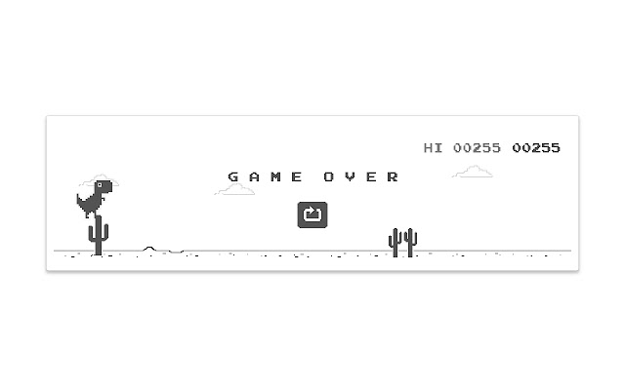
The game
Playable character is a dinosaur
Character is constantly moving right
Character can jump and duck
Obstacles are cactuses on the ground and birds in the air
Game ends when the character touches an obstacle
Goal: Collect as many point as possible by keeping the game going

Slide 3
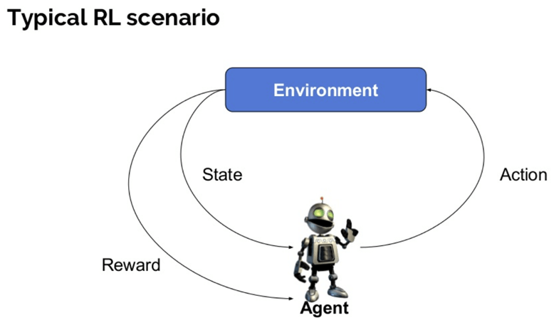
The algorithm
Using Reinforcement Learning algorithm using Deep Q Learning (DQN)
States are defined positions of obstacles relative to the character, etc.
Actions are jump, duck or do nothing
No external data required

Slide 4
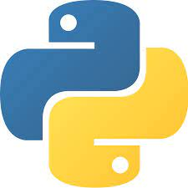
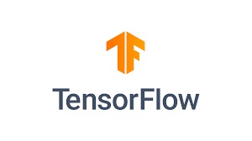

The technology
The game will be built in python
Algorithm will use a ML library in python (such as Tensorflow)
Application will be run online through Heroku

Slide 5
Use cases
When the user enters, they have 3 options: 1. Play, 2. Watch untrained AI play, 3. Watch trained AI play
1. Play lets the user play the game for themselves, if they get a highscore, they receive a congratulations message
2. Watch untrained AI lets the user watch a new model train until they click the quit button
3. Watch trained AI lets the user watch the trained model play the game until they click the quit button

Slide 6
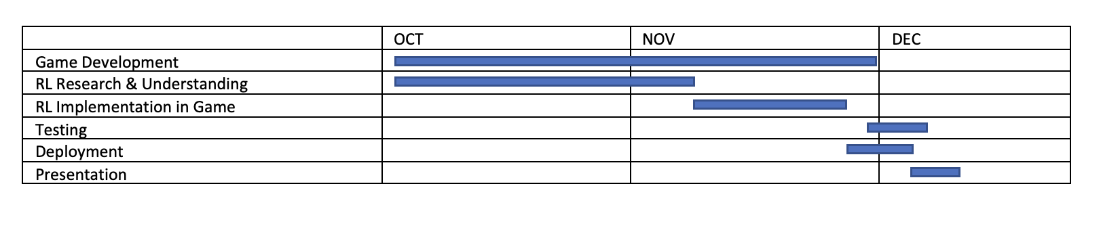
Project Plan
PS: We made the plan with a lot of flexibility except the milestones set by the PM himself. We understand things may change based on circumstances while working on the project.

